Slide 1
Outline
Session I : Theory Session
  Basics of Machine Learning & Data Mining
  Basics of R
  Research topics in Machine Learning & Data Mining
  Useful resources
Session II: Practical
  R/ Rstudio Installation
  Basics of R
  Model Building: Classification and Regression.
  Result Analysis

Slide 2
Session I: Theory
  Basics of Machine Learning & Data Mining
  Basics of R
  Research topics in Machine Learning & Data Mining
  Some useful resources

Slide 3
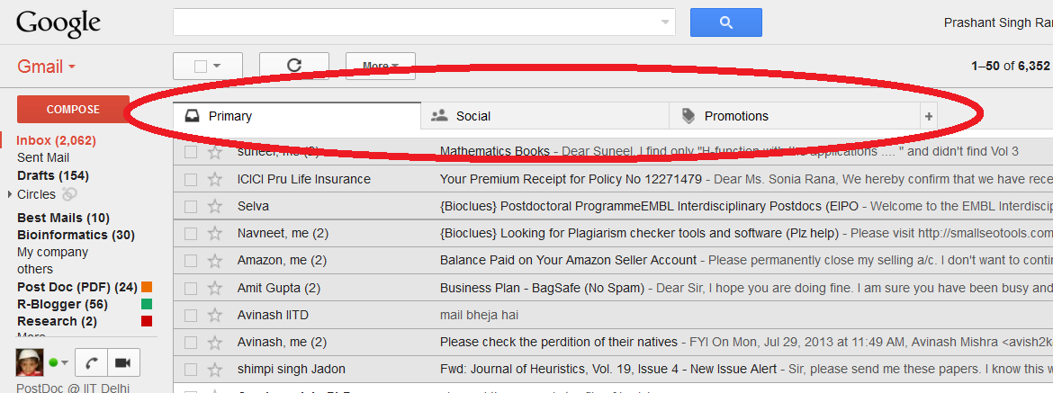
What is Machine Learning ?
Example1: email classification in Gmail

Slide 4
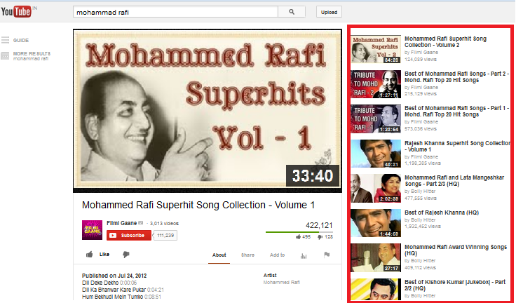
What is Machine Learning ?
Example2: suggestion in youtube

Slide 5
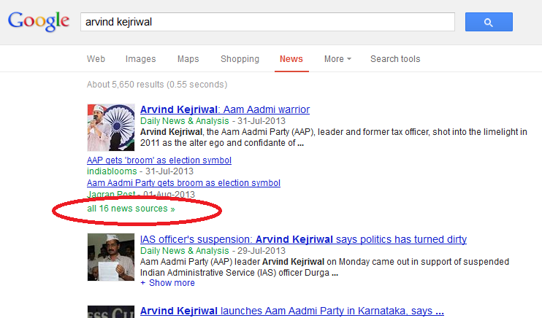
What is Machine Learning ?
Example3: Google News

Slide 6
What is Machine Learning ?
Some more examples
Classification of e-mail into SPAM or NON-SPAM
Classification of transaction as FRAUD or GENUINE
Patients diagnosed as DIABETIC or NON-DIABETIC
Gene Classification into CODING or NON-CODING.
…… Many more.

Slide 7
What is Machine Learning ?
Simple Definition I - Branch of Artificial Intelligence that gives computers to learn without being explicitly programmed.
Simple Definition II - Branch of Artificial Intelligence, about to construct a system that learn from data.
Actual Definition - A computer program is said to learn from experience E with respect to some task T and some performance measure P, if its performance on T, as measured by P, improves with experience E.

Slide 8
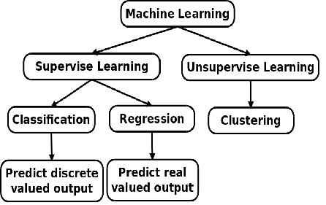
Categories of Machine Learning

Slide 9
Supervised/Unsupervised Learning
Supervised Learning It is the machine learning task of inferring a function from training & testing data.
Example: Classification & Regression Problems.
Unsupervised Learning refers to the problem of trying to find hidden structure in unlabeled data.
Example: Clustering Problems.

Slide 10
Examples
Regression Problem
  Prediction of wheat production.
  Prediction of rainfall.
  Point prediction of Stock Exchange.
Classification Problems
  Prediction of cancer.
  Win prediction of Sheila Dixit.
  Diabetic Prediction.
  Classification of e-mail.

Slide 11
Examples
Clustering
  Grouping of NEWS.
  Grouping the people on their similar hobbies/interests.
  Grouping of animals.
  Grouping of customers based on their performance. E.g. bank customers.
  ………….. Many more.

Slide 12
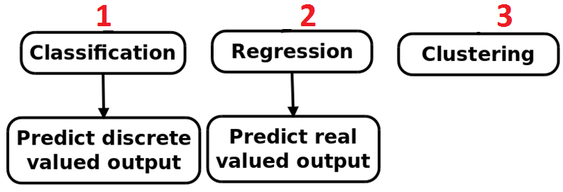
You have to only deals with ……..

Slide 13
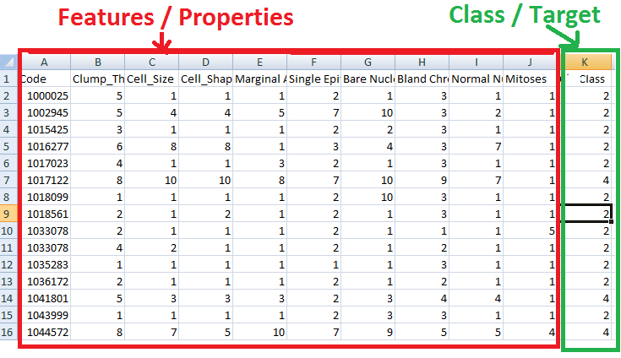
Understand the Data……..

Slide 14
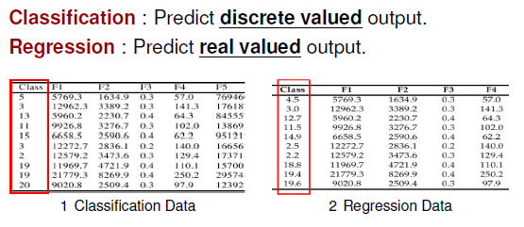
Classification & Regression

Slide 15
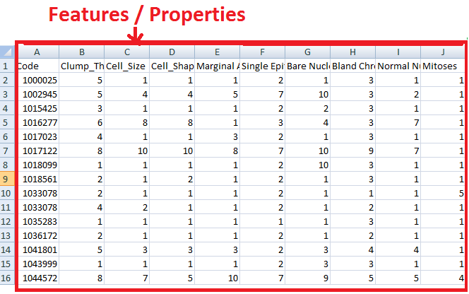
Clustering Data
Only Features; No class/target/label

Slide 16
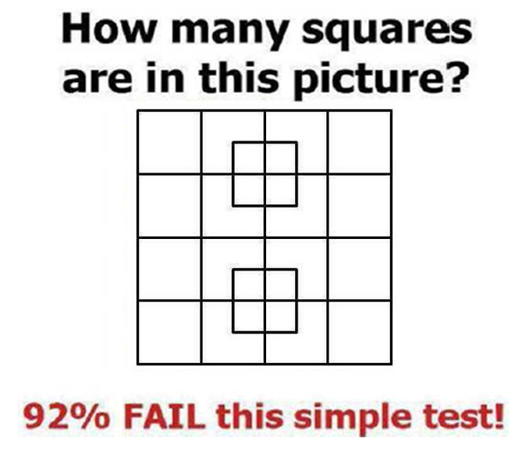
Quiz1

Slide 17
R
What is R?

Slide 18
R
R is a free and open source software for statistical computing and graphics available for Linux, Windows and MacOS platforms.
R provides a wide variety of statistical models
  Linear and nonlinear modeling.
  Classical statistical tests.
  Time-series analysis.
  Classification/Clustering/Regression Models.

Slide 19
R … cont.
an effective data handling and storage facility,
a suite of operators for calculations on arrays, in particular matrices,
a large, coherent, integrated collection of intermediate tools for data analysis,
graphical facilities for data analysis and display either on-screen or on hardcopy, and
a well-developed, simple and effective programming language which includes conditionals, loops, user-defined recursive functions and I/O facilities.

Slide 20
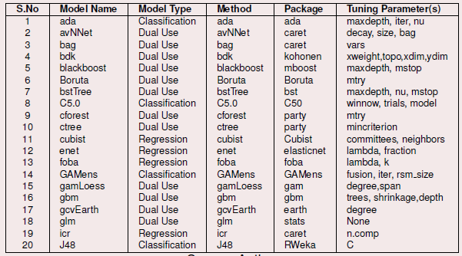
Machine Learning models available in R

Slide 21
Machine Learning models available in R
Most Common models
  Decision tree model
  Random forest
  SVM (Support Vector Machine)
  Linear Model
  Neural Network

Slide 22
Types of Models
Linear Model
Y= w1 x1 + w2x2 + w3x3 + w4x4 + w5x5
Tree Based model
X1 < 40
X2 < 10
X2 < 90
X3 < 5
X3 < 9
X3 < 10
X3 < 90

Slide 23
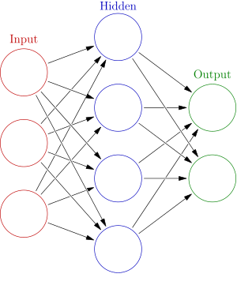
Types of Models……..
Neural Network

Slide 24
Rattle
What is Rattle?

Slide 25
Rattle
Rattle is free and open source GUI tool for data mining.
Rattle is used without writing a single code in data mining projects.
Rattle is built on the statistical language R
Rattle is simple to use and quick to deploy.
Rattle allow data processing, modeling, and evaluation phases of a data mining project.

Slide 26
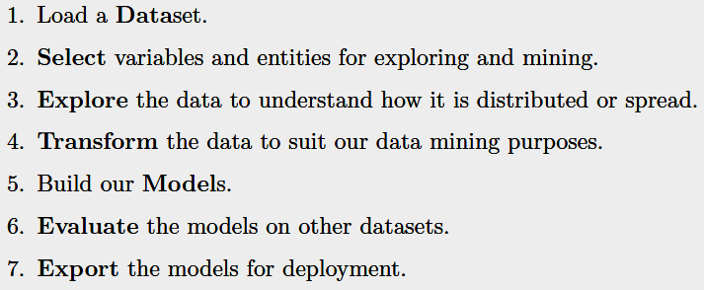
Rattle
Workflow of Rattle

Slide 27
Data Set
Where to get the datasets ?

Slide 28
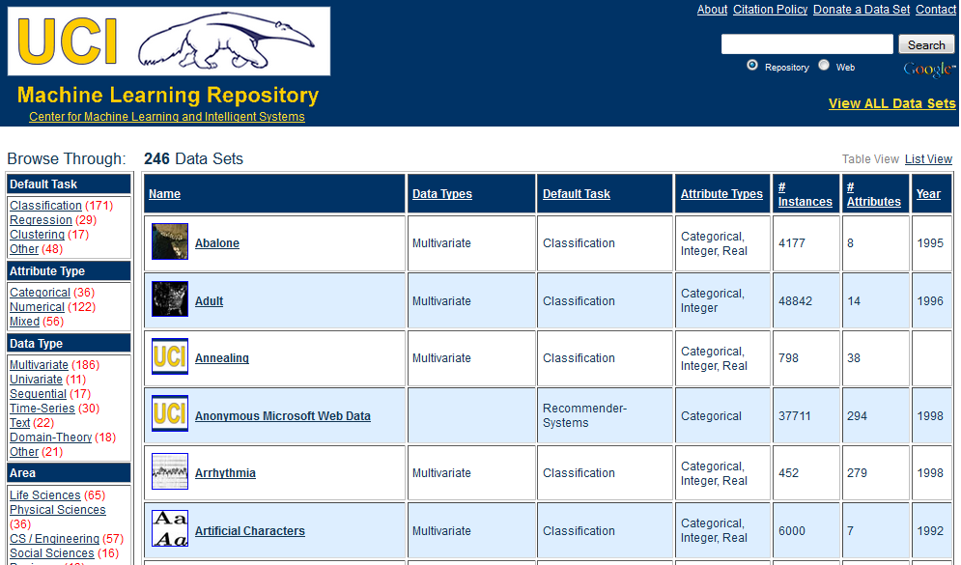
Data Set : UCI Library
Google→ “uci dataset”

Slide 29
Flow of data mining

Slide 30
Step1: Data Collection
Justify your data.
Purpose of your data.
Primary data or secondary data.
Type of data – single variant or multi variants.
Mention features of you dataset.
……… many more

Slide 31
Step2: Data Cleansing
Remove redundancy.
Removing missing values.
Normalize/transform your data.
……… many more

Slide 32
Step3: Feature Selection
It is a subset problem.
Select then minimum set features that gives best performance.
Compare the different features methods on prediction model performance.
……… many more

Slide 33
Step4: Division of data into Training & Testing
Divide the data into training & testing.
General rule 70-30.
  Train the model on 70% data
  Test the model on 30% data.
Try more combinations, like 50-50, 60-40, etc.
……… many more

Slide 34
Step5: Train the Model
Train the model on 70% data

Slide 35
Step6: Test the model
Test the model on 30% data

Slide 36
Step7: Cross Validation
Cross Validation is used to check the robustness of the model.
K-fold Validation is used.
Repeat Step 4 and Step 5 , 10 times
( 10-fold validation), observe the performance and plot the graph.

Slide 37
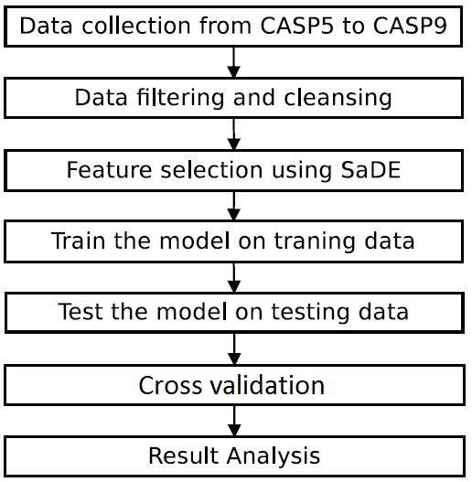
Flow of data mining

Slide 38
Some
Useful Resources

Slide 39
Useful Resource
Books
Applied Predictive Modeling
by Max Kuhn & Kjell Johnson
Data mining with Rattle and R
by Graham Williams

Slide 40
Useful Resource
Software - I
http://www.r-project.org
This is the main R web site with links to announcements, manuals, books, conference, and other information.
http://cran.r-project.org
CRAN, or the Comprehensive R Archive Network, is the primary repository for R and numerous add-on packages.
http://cran.r-project.org/web/views/MachineLearning.html
The machine learning Task View is a list of many predictive modeling packages in R.
http://caret.r-forge.r-project.org
The caret package is hosted here.

Slide 41
Useful Resource
Software – II
http://www.rulequest.com
RuleQuest releases commercial and open-source versions of Cubist and C5.0.
http://rattle.togaware.com
Rattle (Williams 2011) is a graphical user interface for R predictive models.
http://www.cs.waikato.ac.nz/ml/weka/
Weka is collection of Java programs for data mining.
http://orange.biolab.si
Orange is an open-source, cross-platform graphical user interface to many machine learning tools. The interface is a “pipeline” where users piece together components to create a workflow.

Slide 42
Useful Resource
Software – III
http://www.knime.org
“KNIME (Konstanz Information Miner) is a user-friendly and comprehensive open-source data integration, processing, analysis, and exploration platform.”
http://www.spss.com/software/modeler
The IBM SPSS Modeler, formerly called Clemintine, is a visual platform for model building.
http://www.sas.com/technologies/analytics/datamining/miner
A SAS product for data mining.
Other programs are listed at http://www.kdnuggets.com/software/suites

Slide 43
Useful Resource
Online Courses
www.cousera.org
Machine Learning
By Andrew Ng, Stanford University
www.YouTube.com
Search for “Datamining using rattle”

Slide 44
Useful Resource
Competitions on datamining
http://www.kaggle.com
http://tunedit.org
KDD Cup (Knowledge Discovery in Data)
http://www.kdnuggets.com

Slide 45
Useful Resource
Data Sets
http://archive.ics.uci.edu/ml
The University of California (Irvine) is a well-known location for classification and regression data sets.
http://www.kdnuggets.com/datasets
ACM has a special interest group on KDD. The KDD group organizes annual machine learning competitions.
http://fueleconomy.gov
Site of U.S. Department of Energy that lists different estimates of fuel economy for passenger cars and trucks.
http://www.cheminformatics.org
Contains many examples of computational chemistry data sets.
http://www.ncbi.nlm.nih.gov/geo
Free dataset of microarray, next-generation sequencing, and other forms of highthroughput functional genomic.

Slide 46
Useful Resource
Blogs
  R-bloggers | R news & tutorials from the web
www.r-bloggers.com
  Revolutions: R
blog.revolutionanalytics.com/r

Slide 47
Research Topics in Datamining

Slide 48
Research Topics in Datamining
Topic 1
Feature Selection / Feature minimization /
Dimension Reduction / Feature Extraction
Choosing the smaller set of features that gives better performance of datamining model. Suppose there 1000 features and you have to select minimum set of features ( let say 35).
Find or Develop new/hybrid feature selection method.

Slide 49
Research Topics in Datamining
Topic 2
Performance comparison of different machine learning models on the dataset.
Performance parameters:
  R²
  Correlation
  Accuracy
  Prediction Time
  RMSE (Root Mean Square Error)

Slide 50
Research Topics in Datamining
Topic 3
Validation of your of best selected model.
To check the biasness of model towards data.
Cross validation of best selected model.
K-fold cross validation method;
e.g. 10-fold cross validation.

Slide 51
Paper Writing
By adopting the above said method you can easily write a conference paper.
… But what about Journal…..??

Slide 52
Paper Writing for journal
Your data must be primary i.e own generated data.
New / Hybrid feature selection method must be used.
Compare the performance with 4-5 methods.
Cross validate the performance.

Slide 53
Research Topic in Machine Learning
www.scikit-learn.org
Contain more then100 example with dataset related to real world problems:
Image Processing
Text Classification
Intrusion Detection
Financial / Marketing ….. etc

Slide 54
Session II: Practical
  R/ Rstudio Installation
  Basics of R
  Model Building: Classification and Regression.
  Result Analysis

Slide 55
R & Rattle Installation
Install R
Go To → R Setup → R-3.1.2-win
Install RStudio
Go To → R Studio → RStudio-0.98.1102

Slide 56
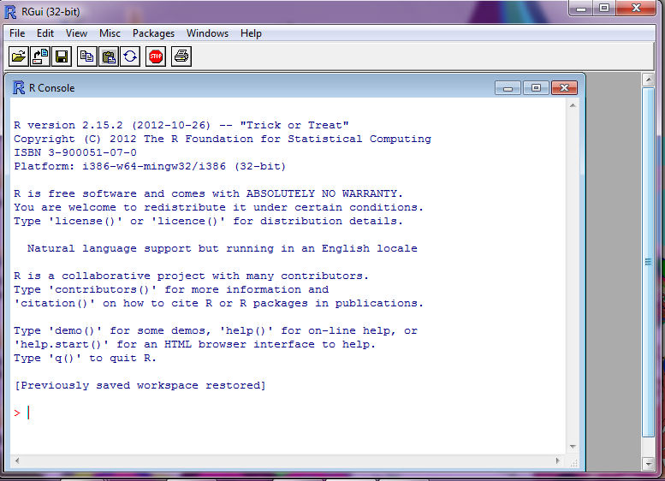
R Installation
First Screen of R

Slide 57
More on R Workshop
Books - R and Machine Learning
Papers

Slide 58
Working with R
Go to Practical Session → Session I
Open R Basics.R

Slide 59
Working with R
Go to Practical Session → Session I
Open R Basics.R
More on R
Go to Practical Session → Manual

Slide 60
Working with Regression Model
Go to Practical Session → Session II
  Explore regressionDataSet.csv

Slide 61
Working with Regression Model
Install the models
  Decision Tree
  Install.packages(‘rpart’)
  Linear Model (default installed)
  Neural Model
  Install.packages(‘rpart’)
  RandomForest
  Install.packages(‘randomForest’)

Slide 62
Working with Regression Model
Explore Models
  Decision Tree
  Linear Model
  Neural Model
  RandomForest

Slide 63
Testing of New DataSet
Go to Practical Session → Session III
  Testing of New DataSet

Slide 64
Working with Classification Models
Multi Class Classification
Go to Practical Session → Session IV
  Explore classificationDataSetMultiClass.csv

Slide 65
Working with Classification Models
Binary Classification
Go to Practical Session → Session V
  Explore brestCancer.csv

